Slide 1

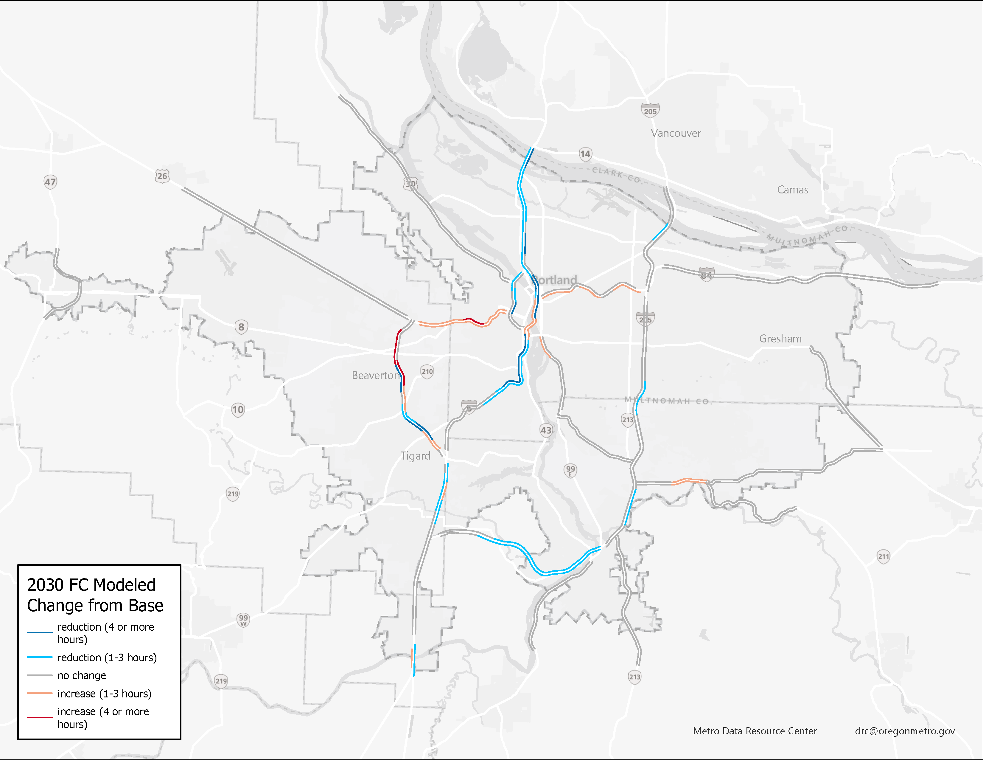
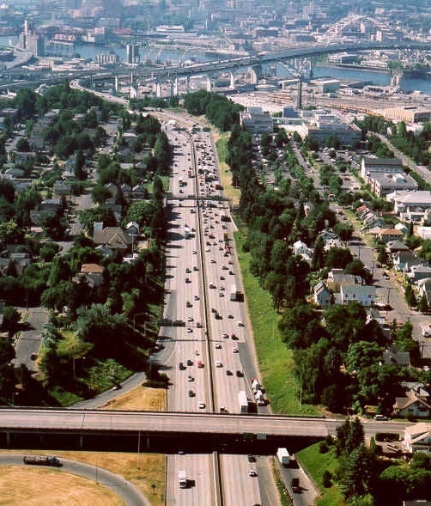
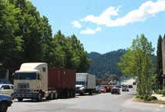

New Methods for Measuring Regional Mobility Augmenting a Regional Travel Model with Big Data
MoMo Conference
Minneapolis, MN
September 15, 2025
Joe Broach, Metro

Slide 2
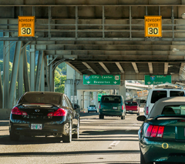
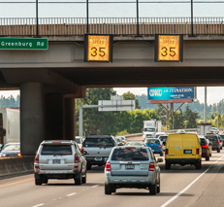
Overview
Updated Regional Mobility Policy includes new speed-based highway performance measure
Chose fusion of “big data” and regional travel model outputs
images: tripcheck.com

Slide 3
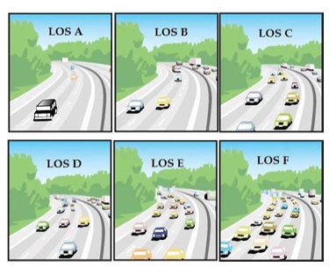
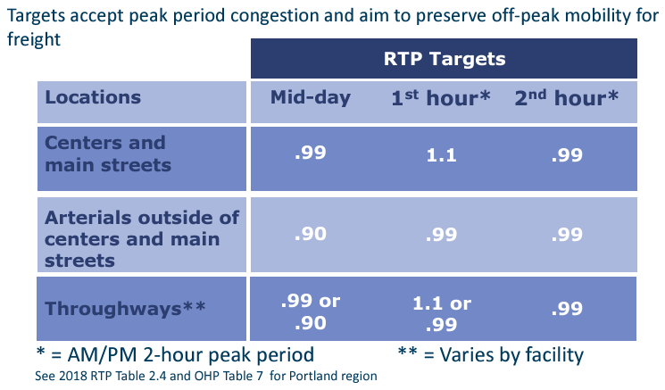
Previous Regional Mobility Policy
Relied on volume/capacity ratios and level of service
Notes:
Working in partnership with the Oregon Department of Transportation since 2019 our region updated our vision for mobility as well the key elements of mobility that should be addressed by the new policy: equity, safety, reliability, efficiency, access and travel options.
It is huge to have our two agencies in agreement on something that sets reasonable expectations for mobility that supports community plans and visions implementing the 2040 growth concept and meeting state and regional equity, climate and safety goals.
This work has shifted the discussion of mobility from simply being about the number of vehicles to moving people, goods and services in a much more tangible and comprehensive way.
The new policy is asking us to think about how much and how far people need to drive, ensuring that we are building a complete multimodal transportation system and managing our system to reduce the number of hours each day travel speeds on the region’s throughways fall below 35 mph.
Go beyond sole focus on motor vehicle congestion standards – to include 3 measures – the VMT/capita as the overarching measure plus system completeness for all modes and travel speed for throughways

Slide 4

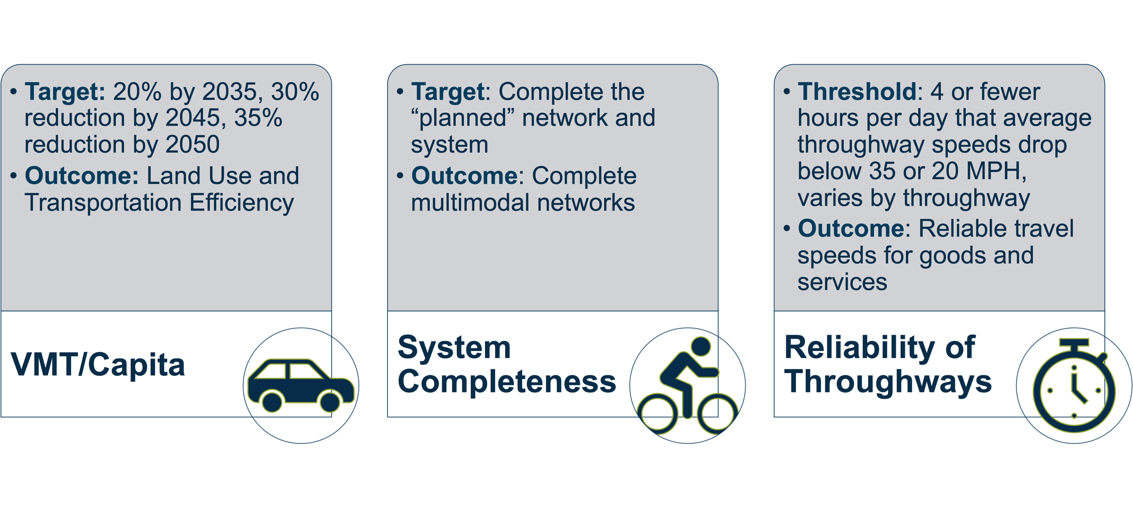
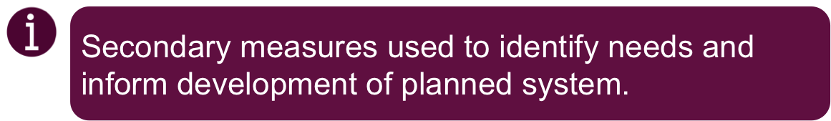
DRAFT mobility policy performance measures and targets/thresholds
Source: Public Review Draft 2023 RTP Chapter 3 (Transportation System Policies to Achieve Our Vision)
Notes:
RTP must demonstrate we achieve 30% VMT/capita reduction from 2005 levels by 2045 to be on track to meeting statewide goals for 2050
RTP defines complete regional system through the network maps
Local TSPs will define complete local system
30-35 mph a clear threshold where conditions tend to be better or worse rather quickly on Interstates and unsignalized throughways. 20MPH was a clear threshold for signalized throughways.
Used to identify areas of poor reliability where due to recurring congestion, average travel speeds drop below these thresholds for more than 4 hours per day. It will be used as a target to identify needs and deficiencies and to assess the percentage of the throughway that meets the target. It will not be applied as a standard that creates conflict with meeting OAR 660 Division 44 VMT per capita reduction targets. Addressing needs will follow the CMPpolicies and process defined in the RTP and RFTP

Slide 5
RMP travel speed reliability analysis framework
Defined RTP
Throughways
Create Analysis Segments
2019
Observed Data (Inrix)
Current and Projected
Performance
Regional Model Estimates (Future)
Hourly assignments

Slide 6
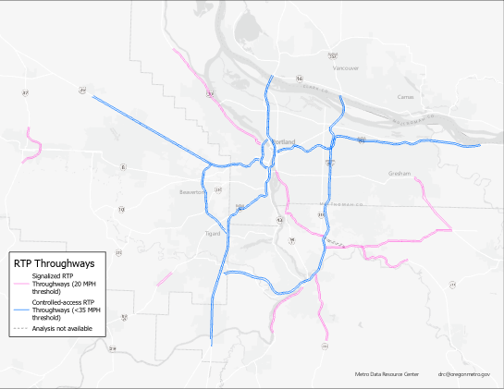
RTP policies designate throughways
in the region
Throughways classified into signalized and controlled-access facilities for analysis.
Controlled-access
Signalized

Slide 7
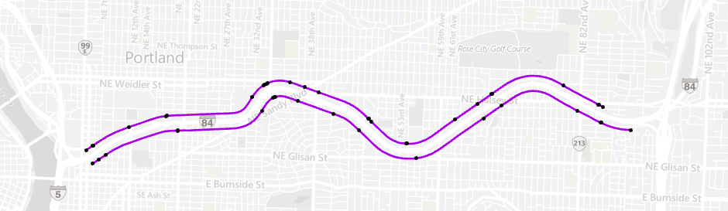
Observed probe data
Continuous vehicle probe data from Inrix, provided by USDOT and State SOT via RITIS platform. Attached to proprietary network (TMC):

Slide 8
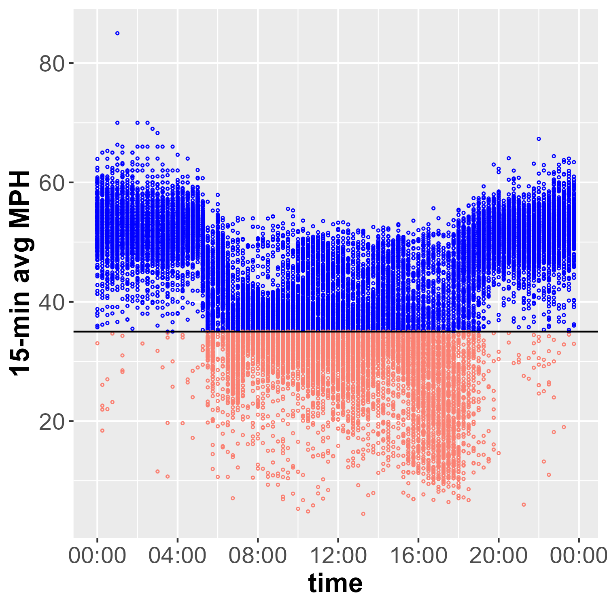
Observed probe data
Annual data for single freeway TMC link, above and below policy threshold (35 mph)
15-minute average speeds for all non-holiday weekdays
Data not always available
How many hours per day is this link below speed threshold??

Slide 9
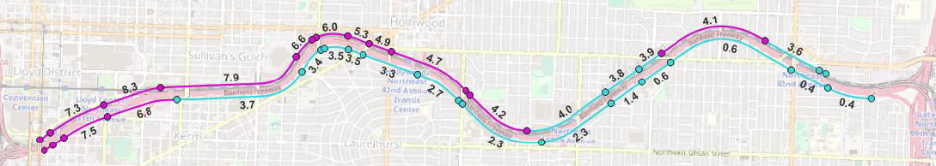
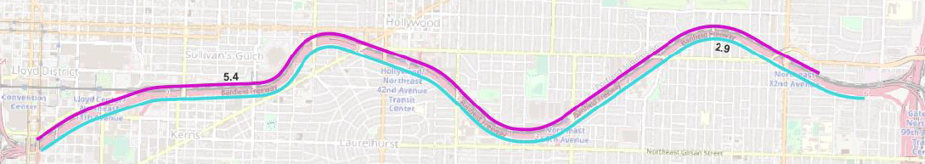
Observed data: summarizing by analysis segment
Calculated average weekday hours not meeting policy for each TMC link. Initially, tested aggregating up to full throughway segments.

Slide 10
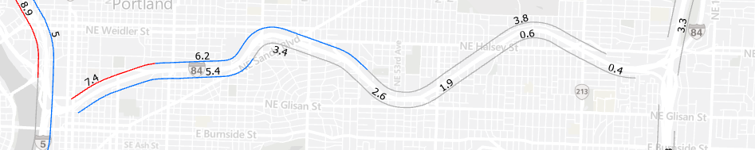
Observed data: revised segments
Tested several segmentation methods, and settled on off-ramp to off-ramp (or between major intersections for signalized throughways)

Slide 11
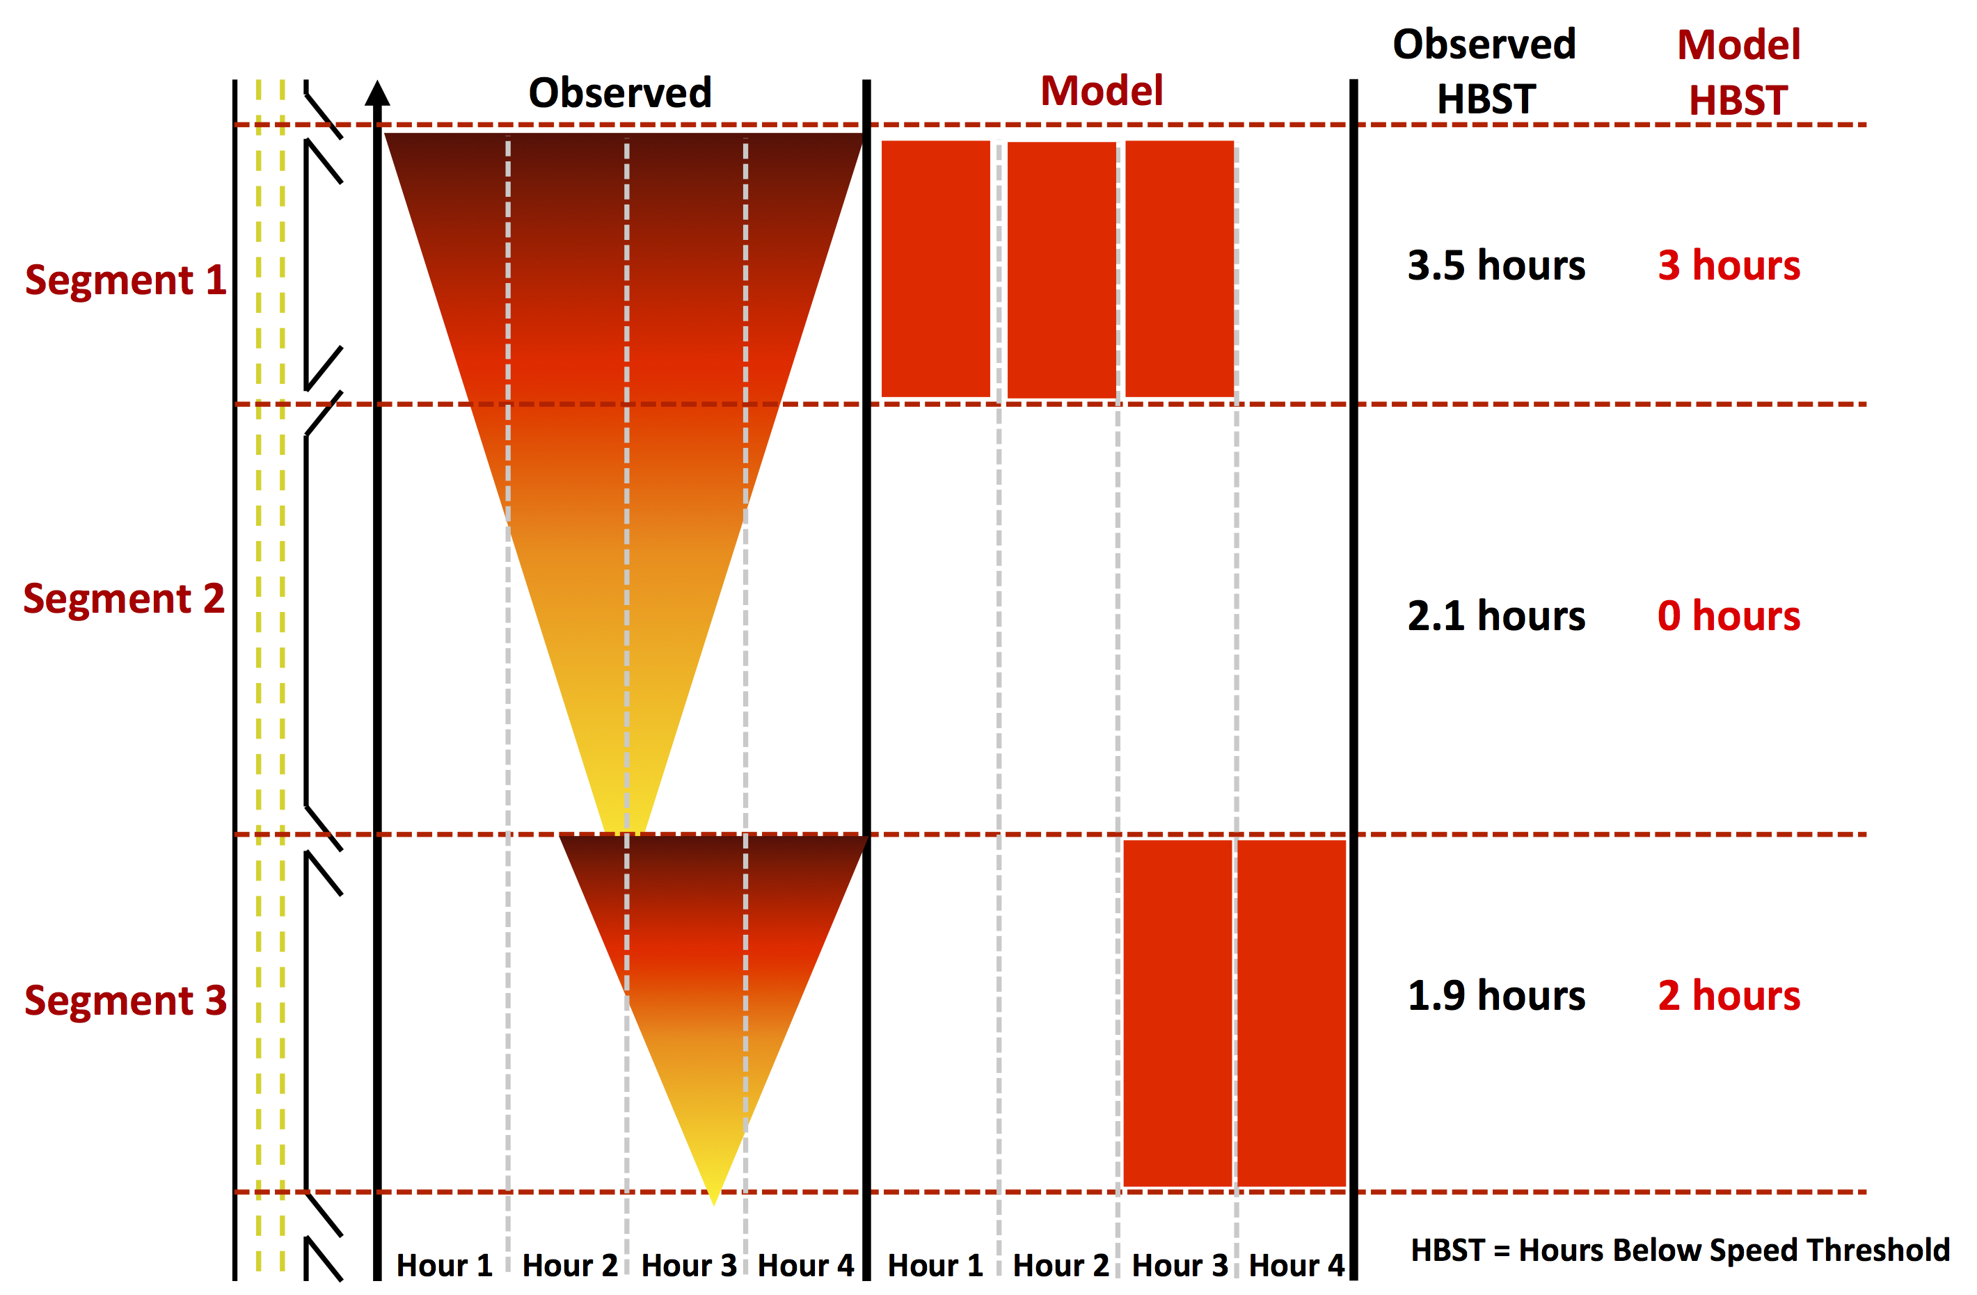
Known limitations of modeled speeds
Hourly Aggregation: Can’t capture congestion that occurs over multiple hour bins
Queuing: Does not capture queuing effects; can underestimate upstream congestion related to bottlenecks

Slide 12
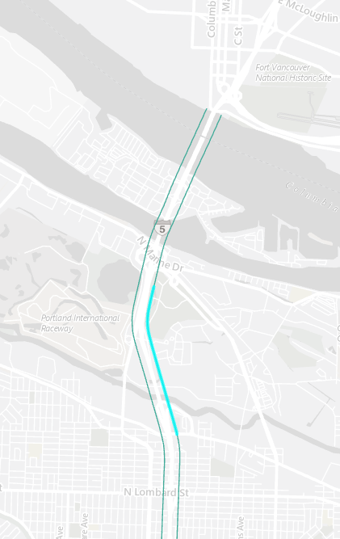
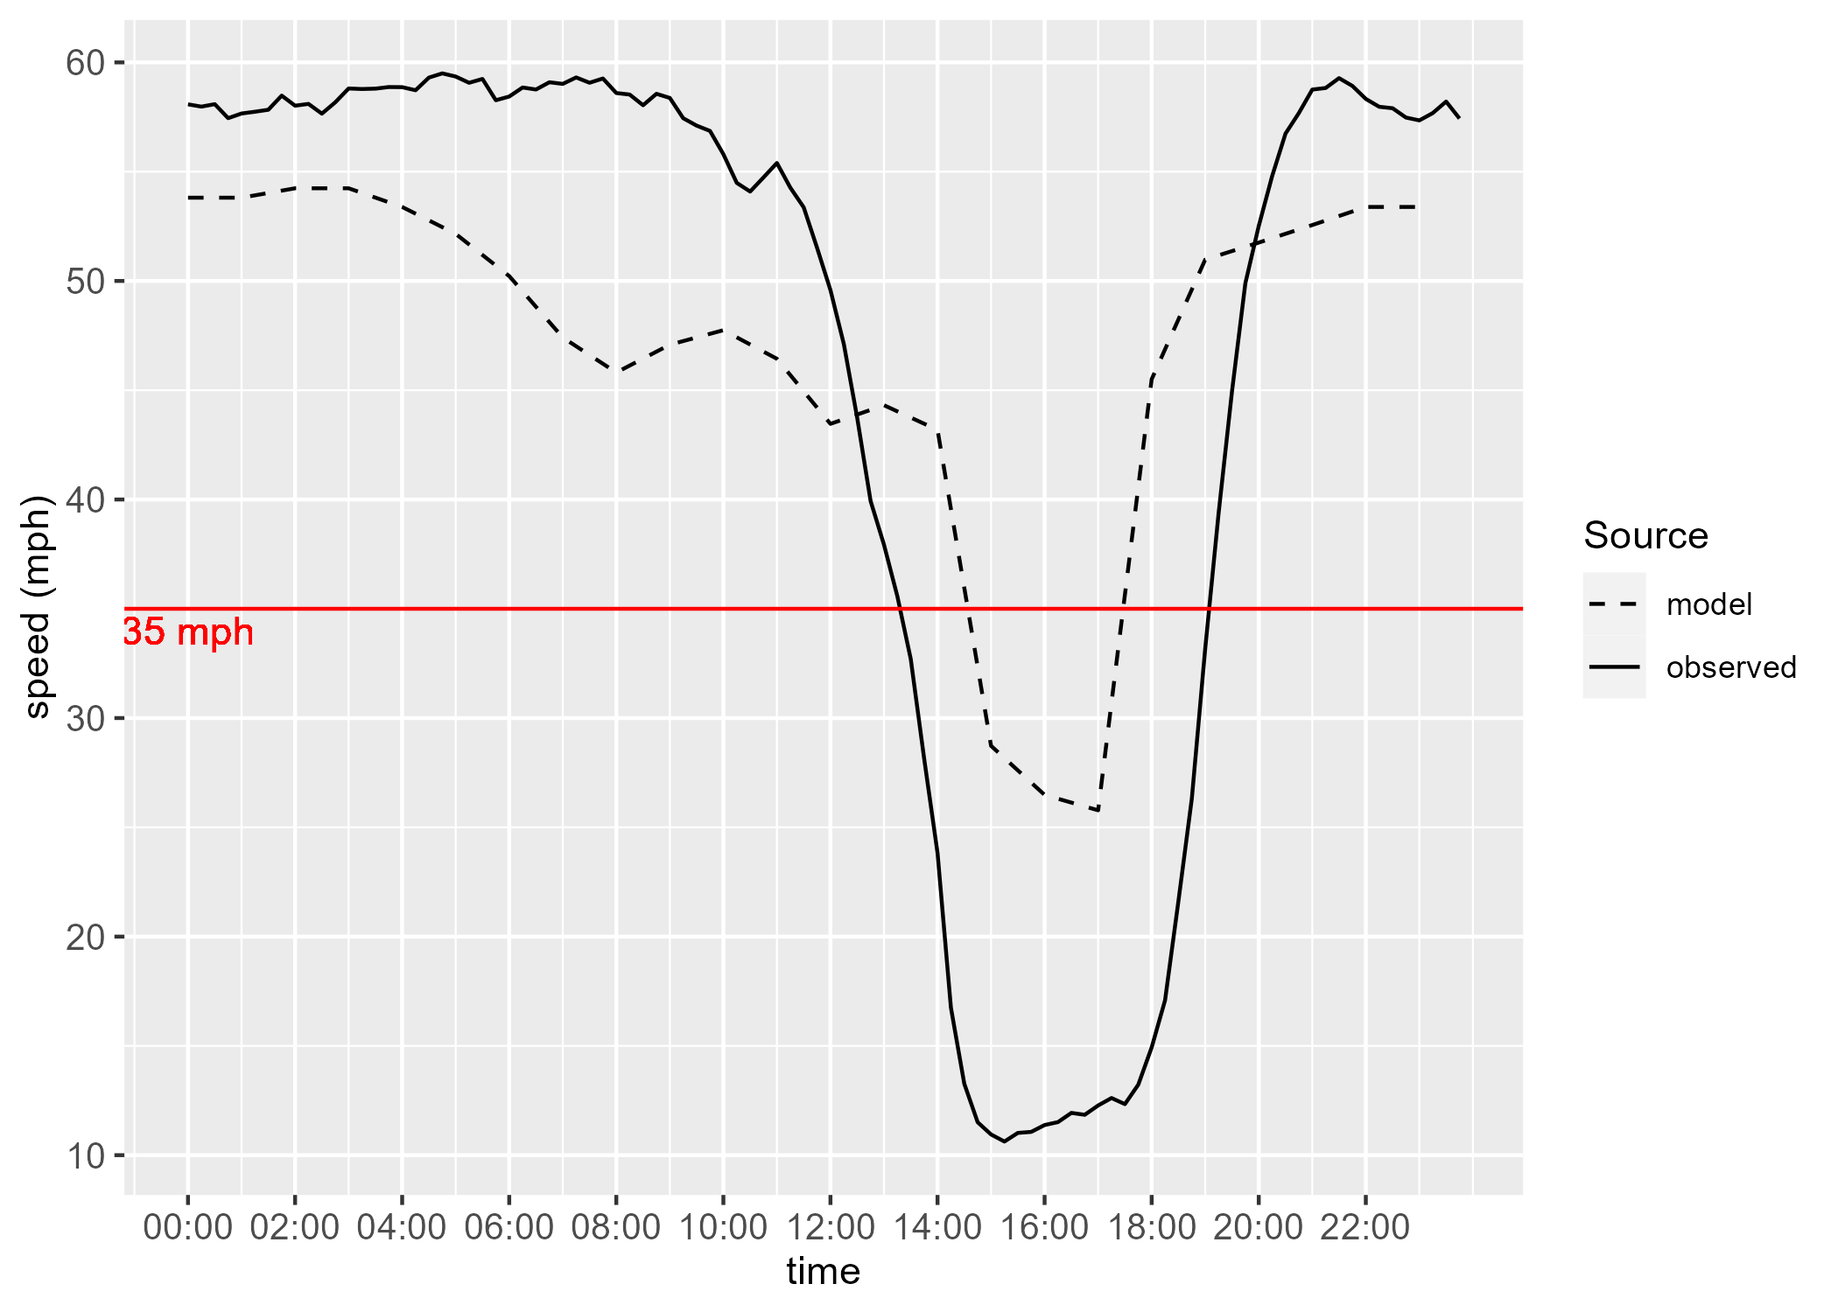
Example: Probe vs. Modeled
I-5 northbound example (I5 NB 23) upstream from Interstate Bridge

Slide 13
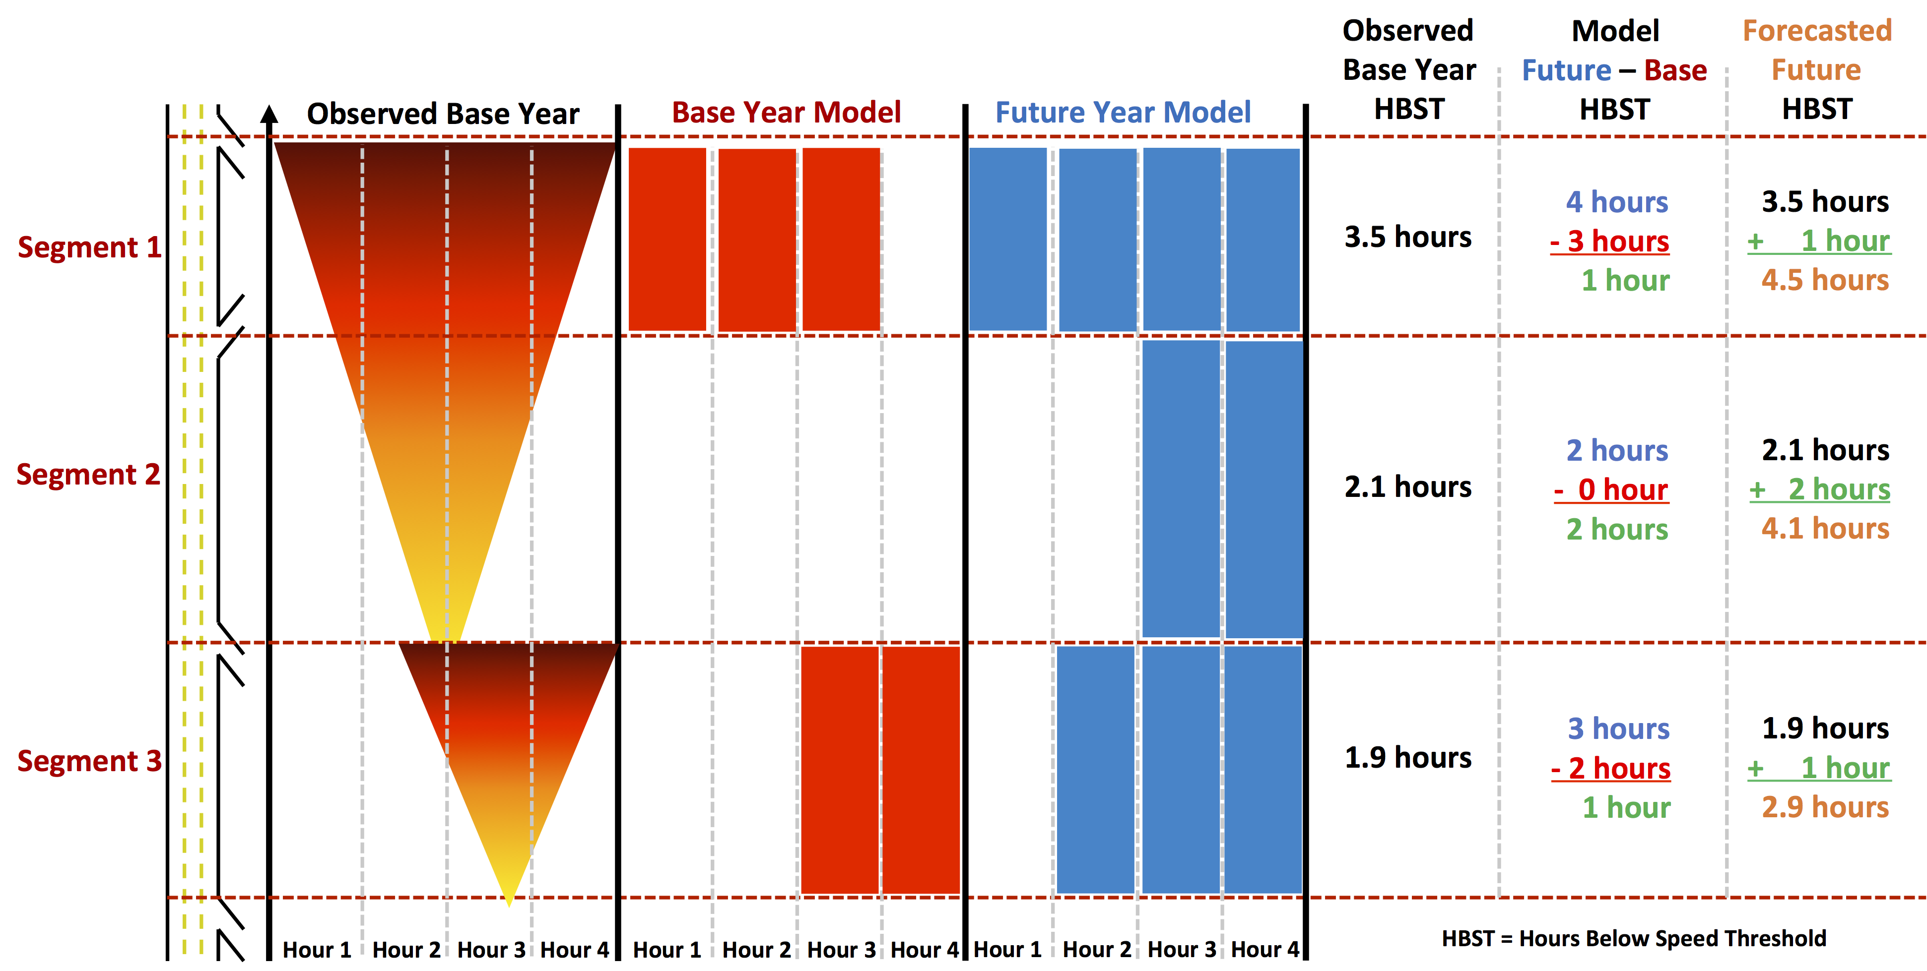
Forecasting using model data

Slide 14
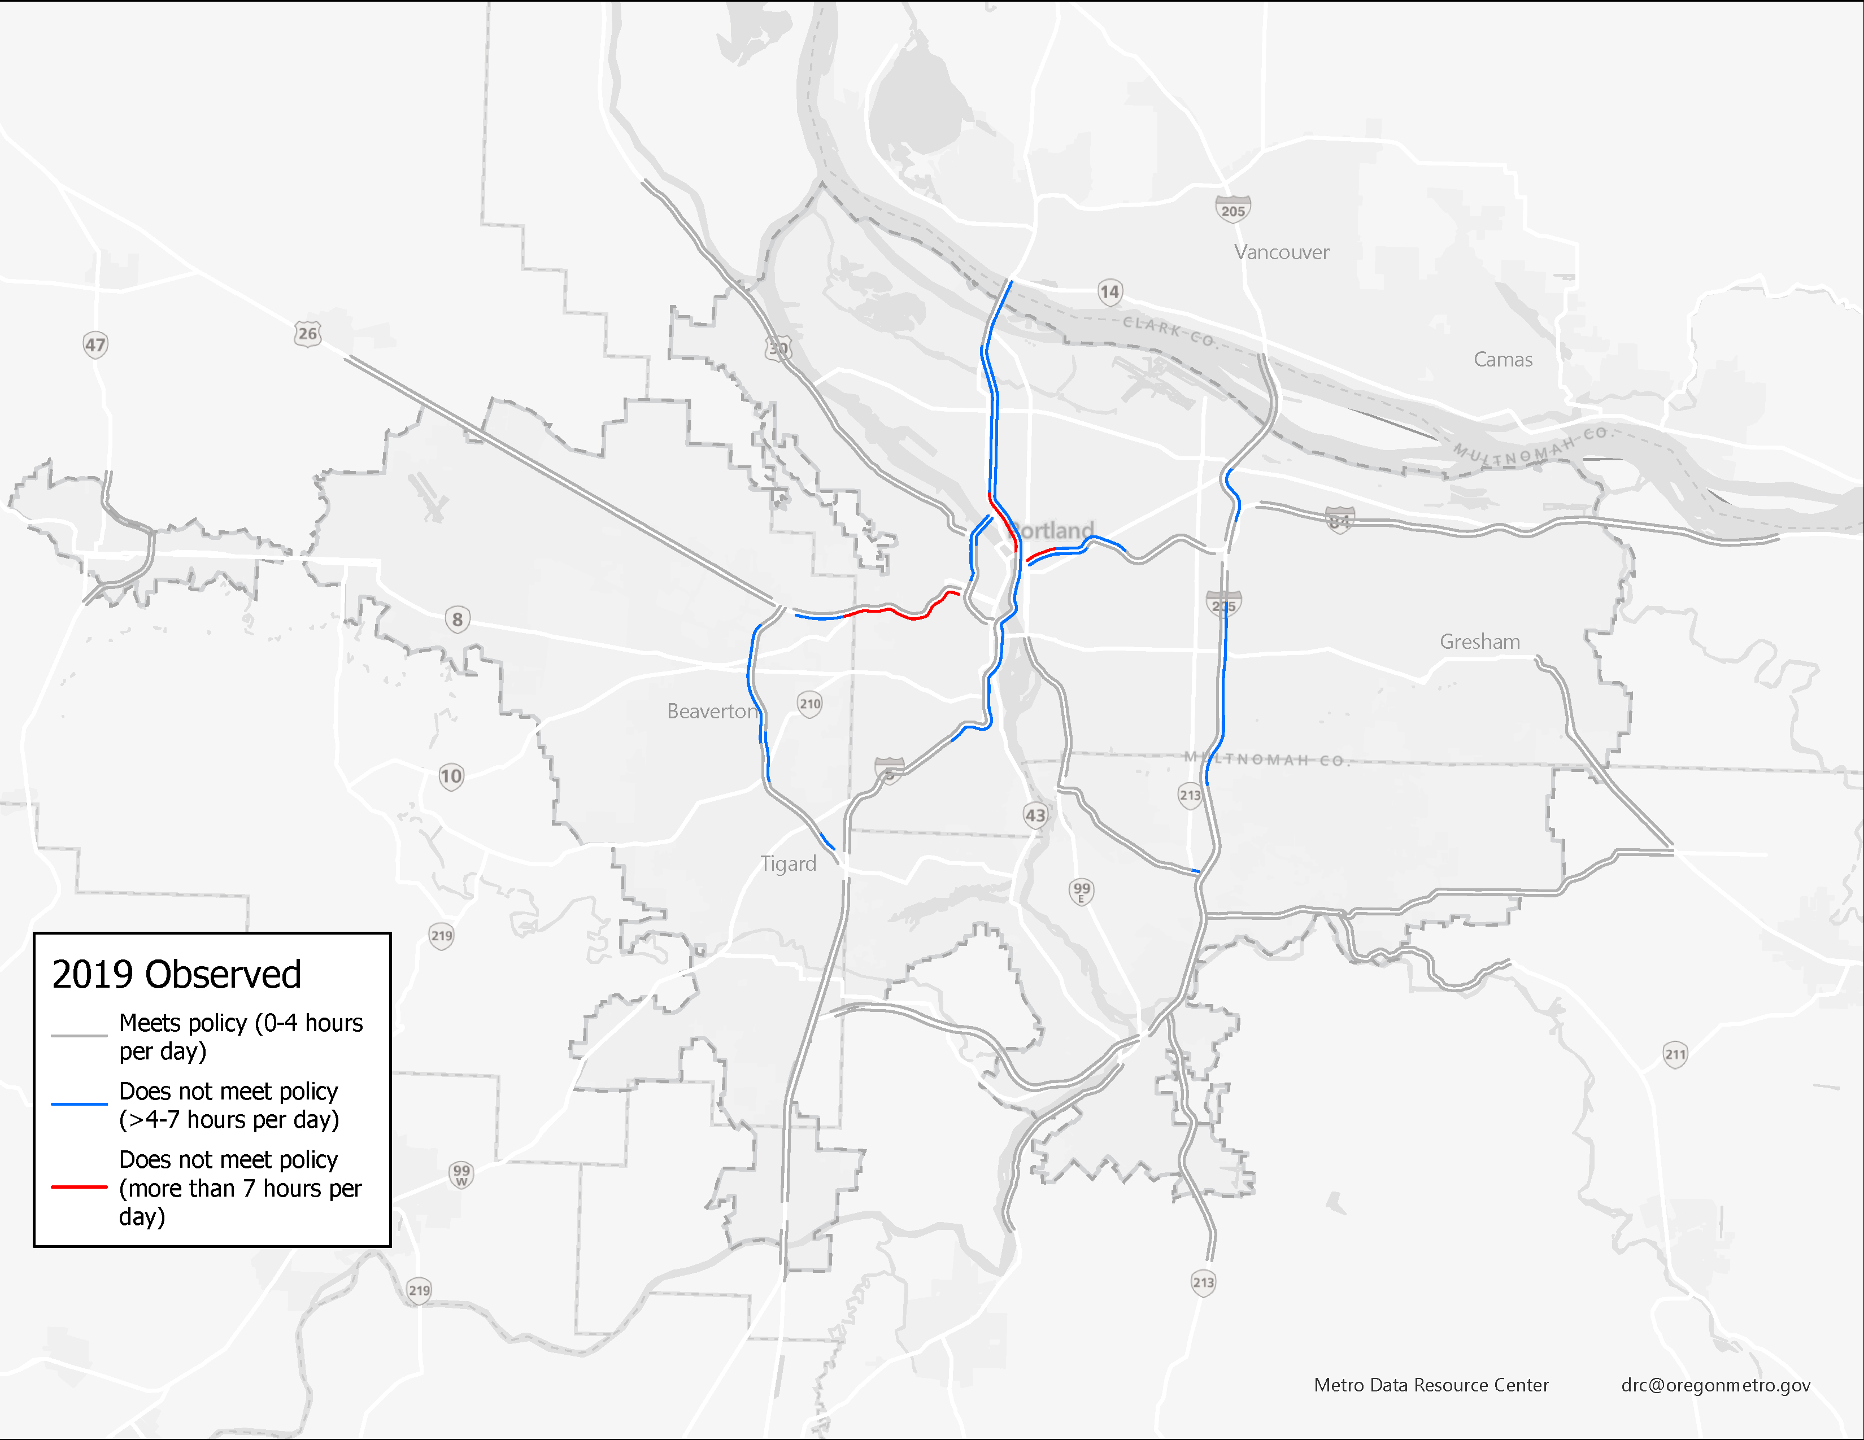
2019 (base year)
2019 (base year: observed data)
Source: Draft 2023 RTP System Analysis

Slide 15
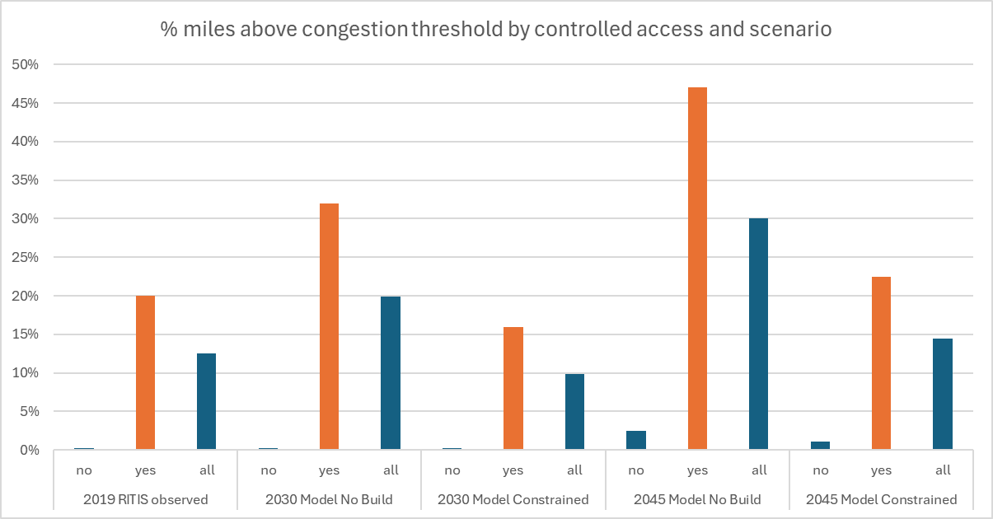
Systemwide Summary
controlled access

Slide 16
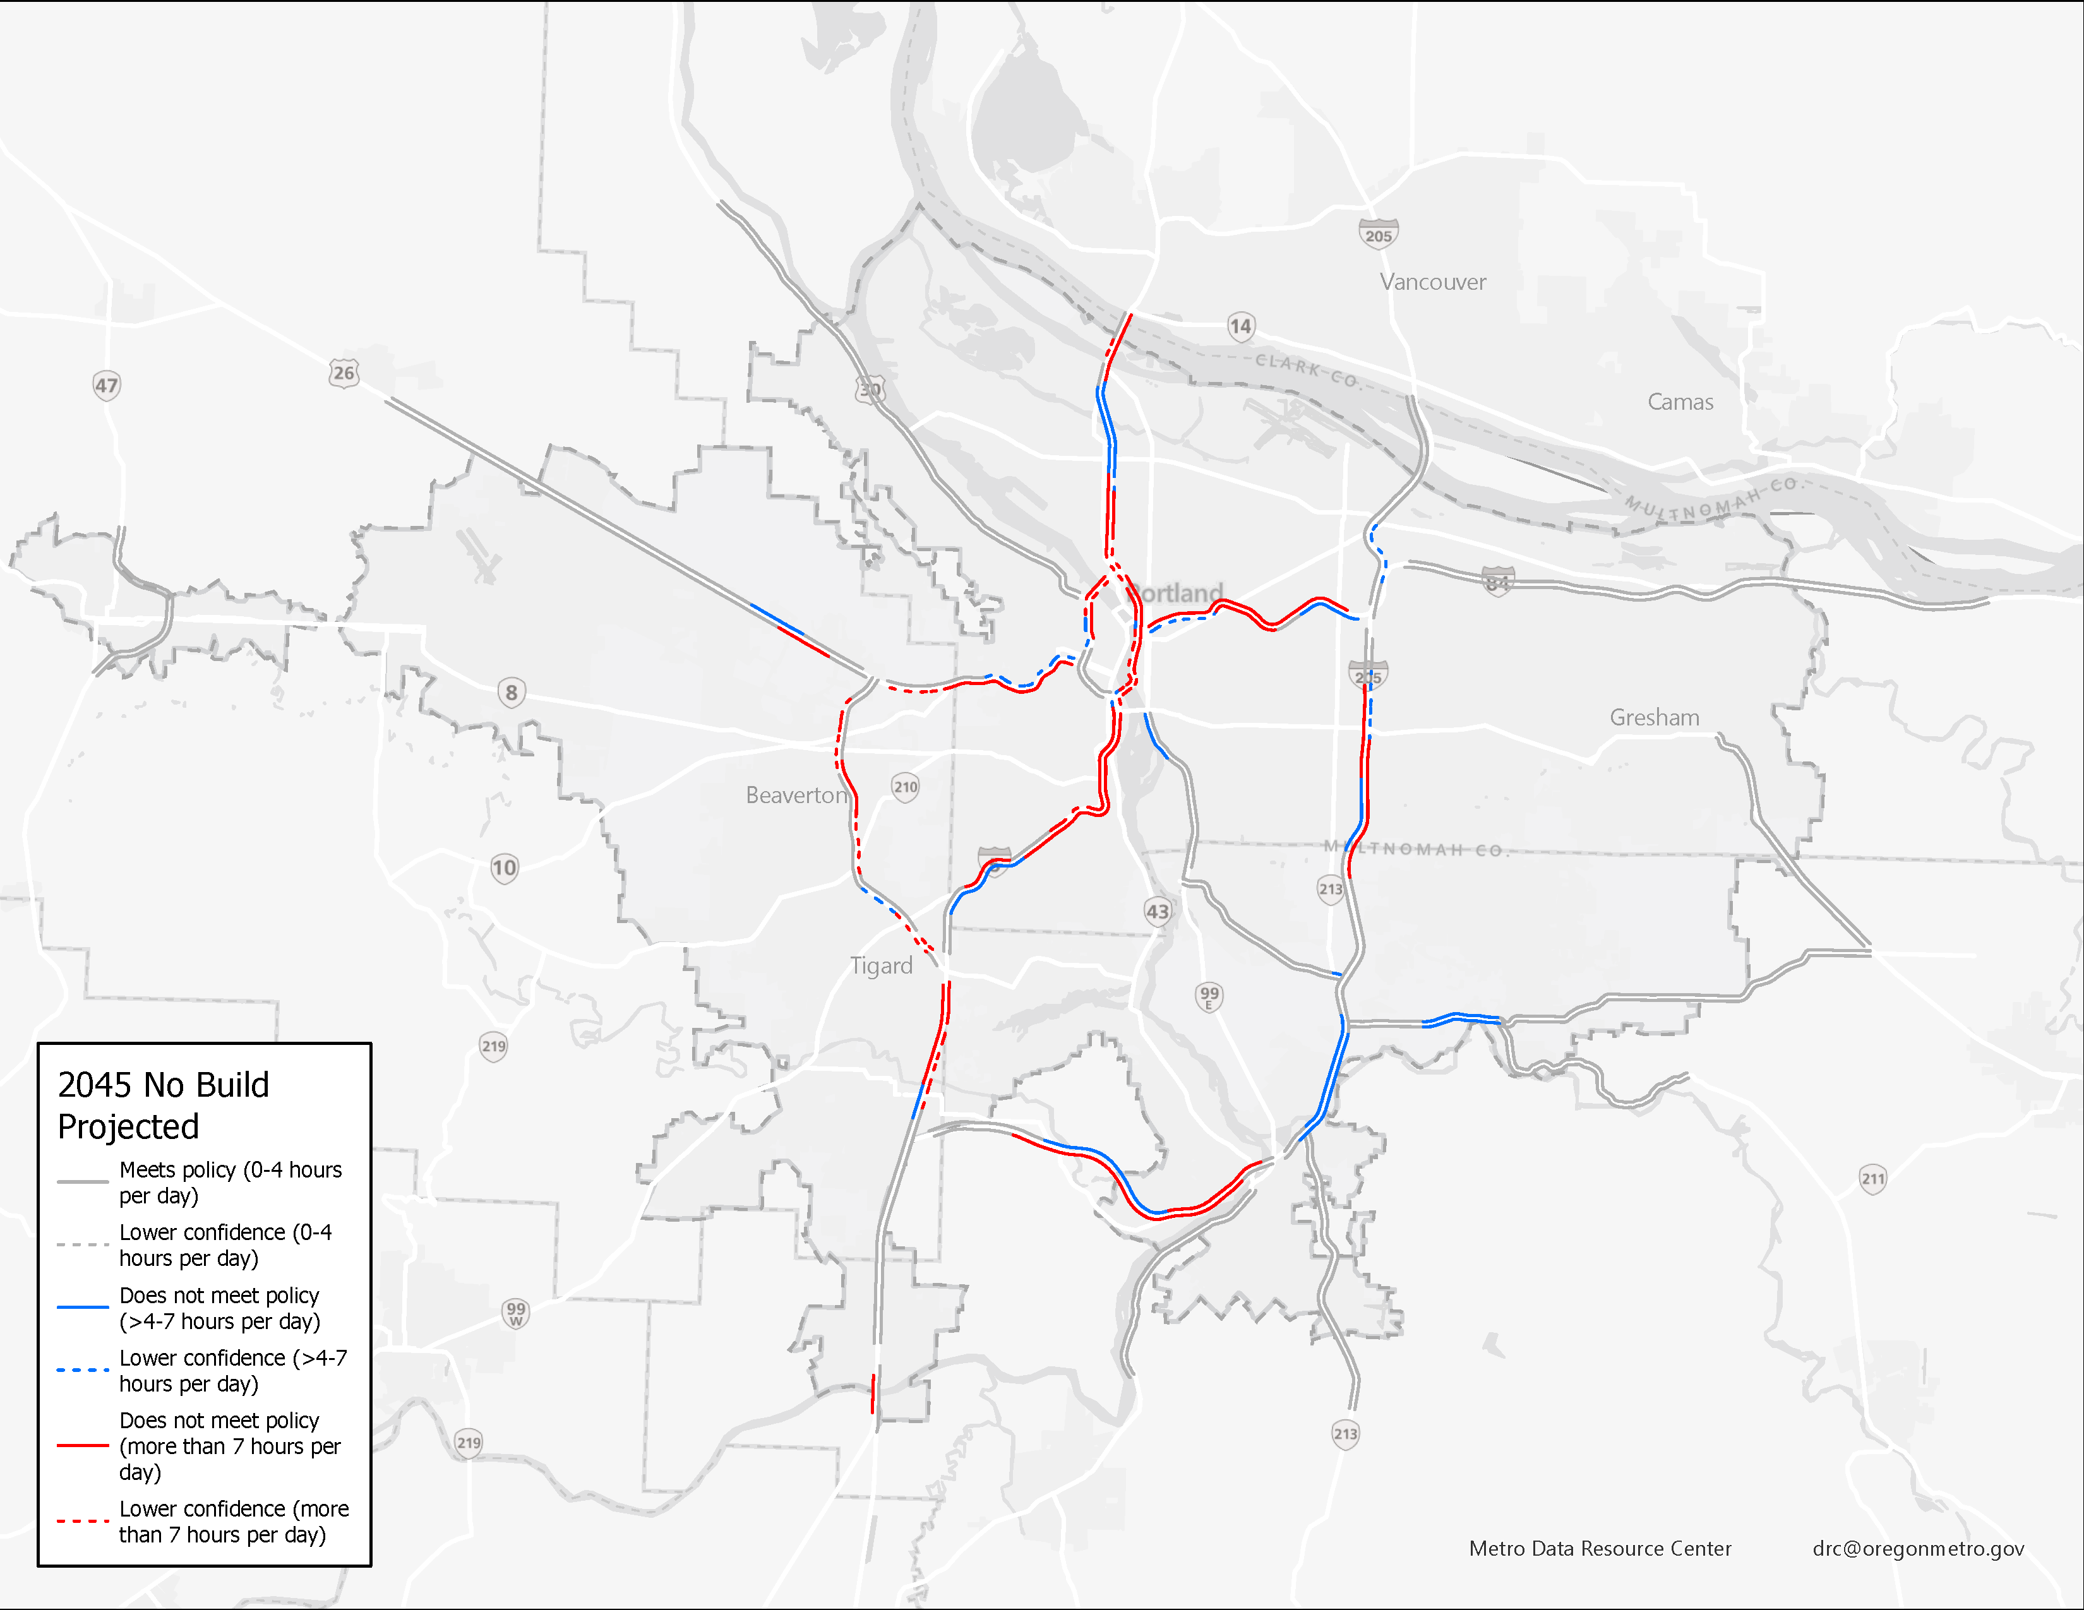
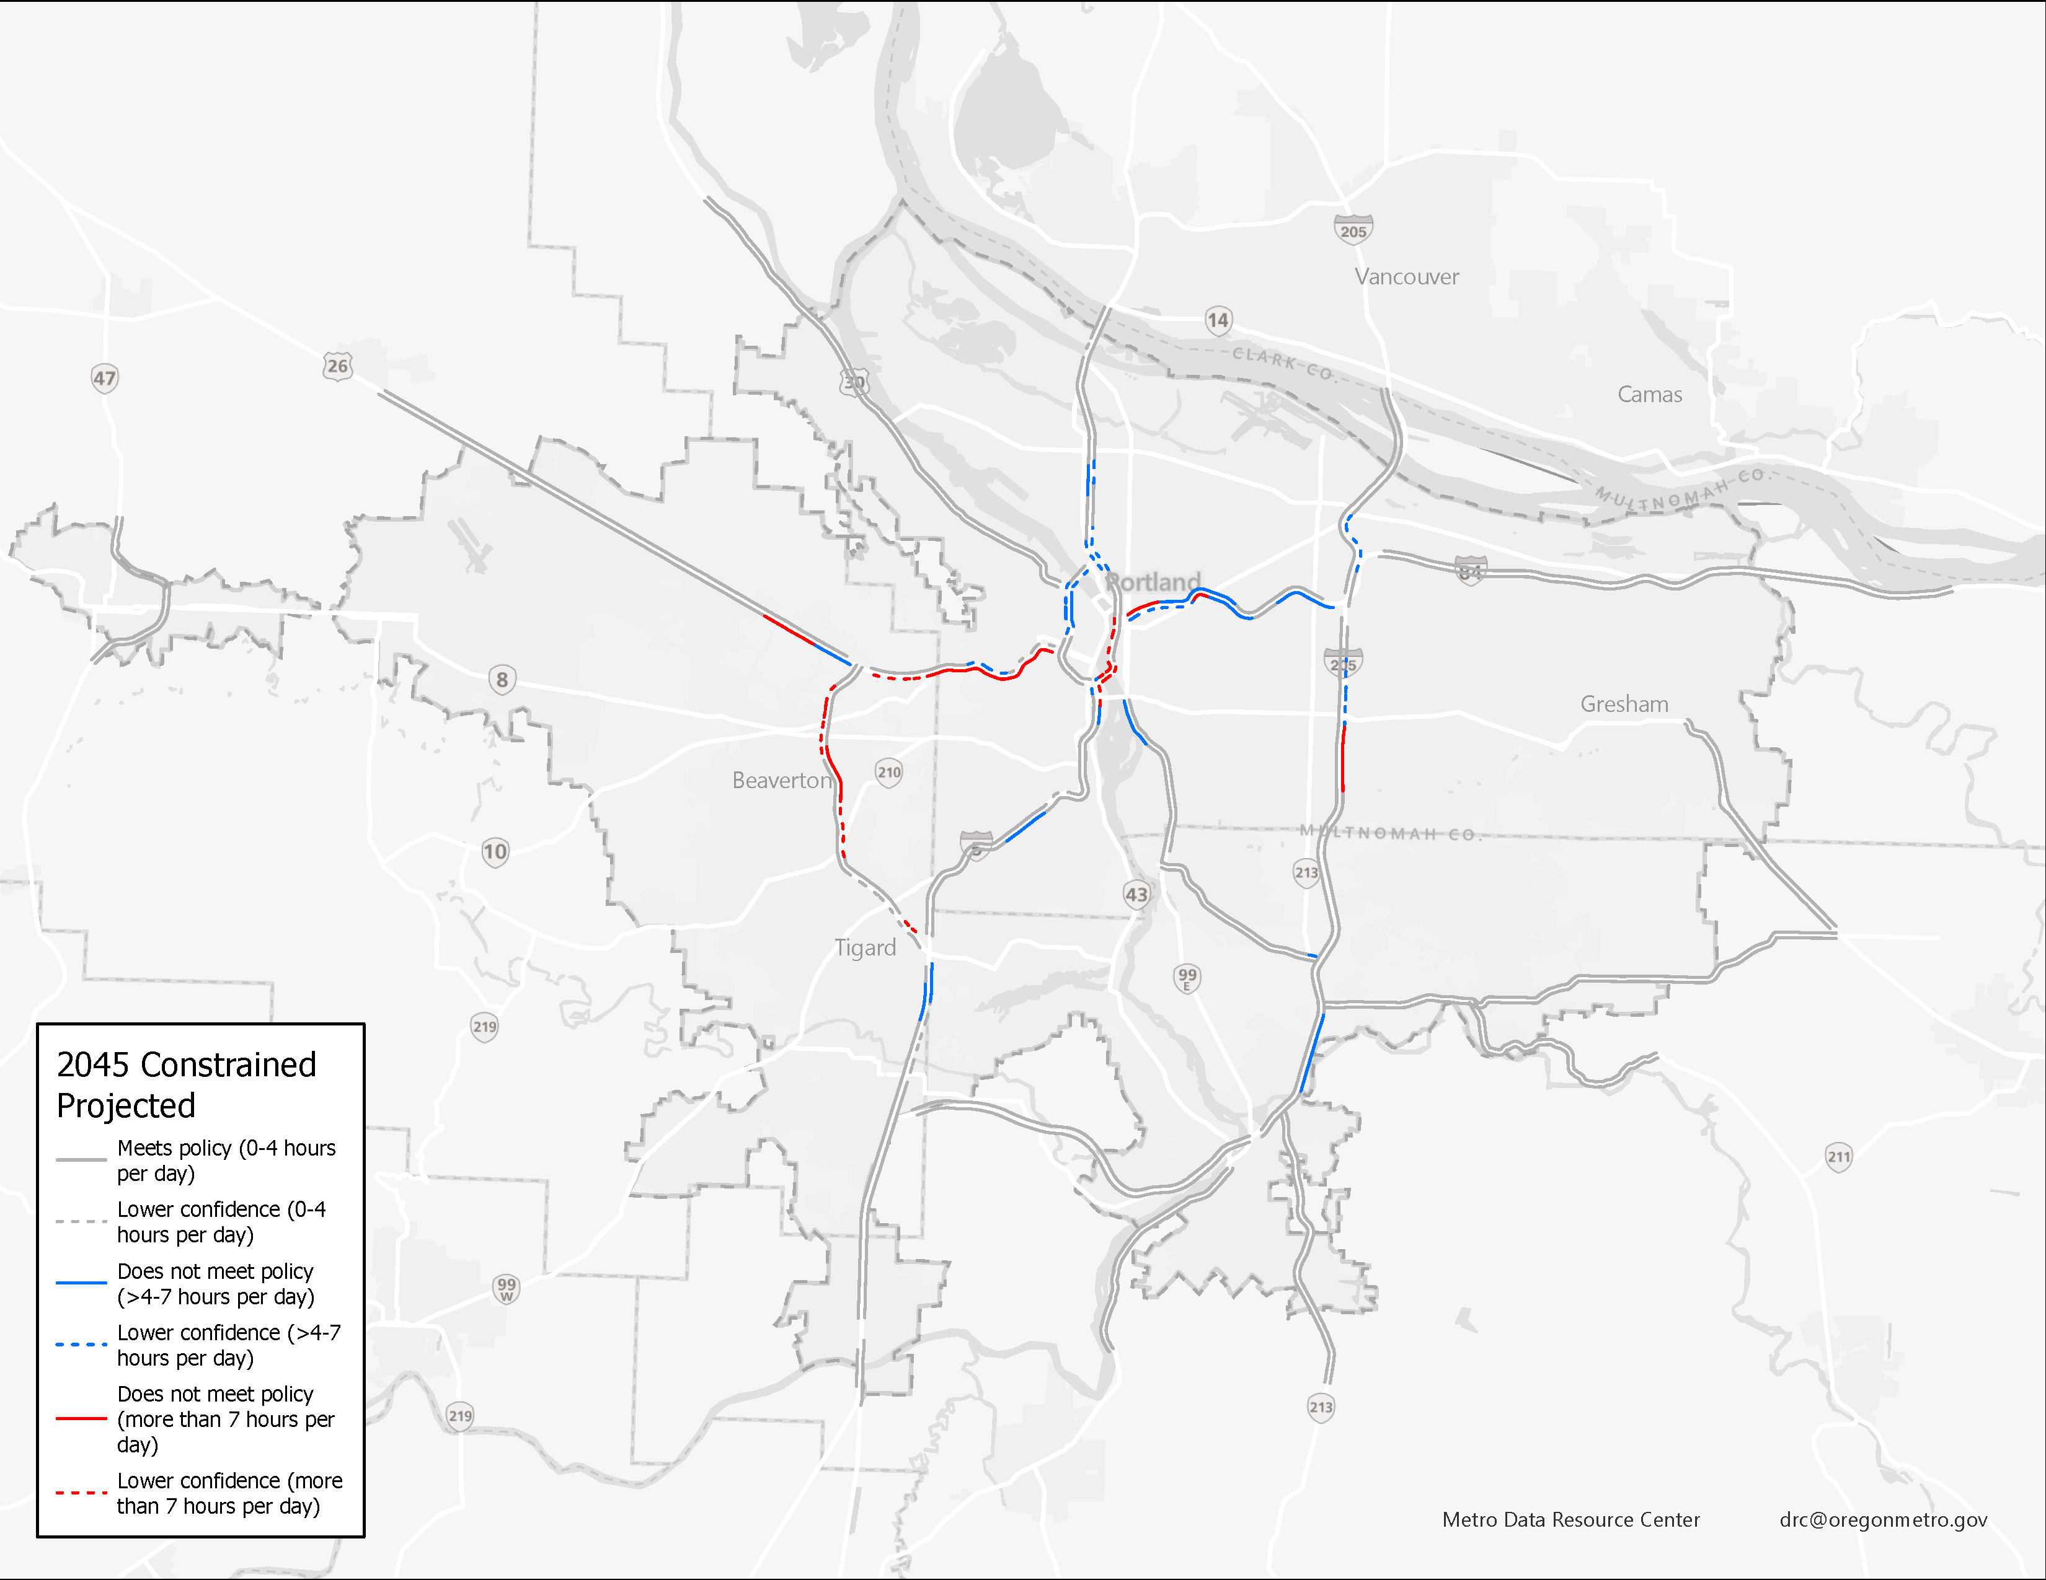
2045 No Build and 2045 Constrained
2045 No Build
2045 Constrained
Source: Draft 2023 RTP System Analysis
Source: Draft 2023 RTP System Analysis

Slide 17
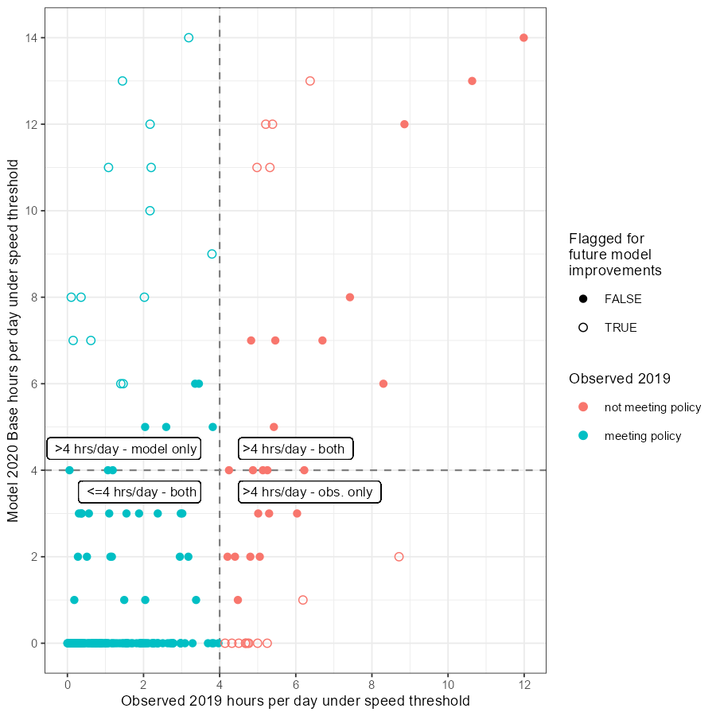
Feedback to ongoing model improvement process
Figure 9 Observed versus Model Base Year Policy Performance

Slide 18
Thank you!
Joe Broach, Metro
joe.broach@oregonmetro.gov
Learn more at:
oregonmetro.gov/mobility
Special thanks also to:
Peter Bosa & Kim Ellis, Metro
Glen Bolen, ODOT

